Slide 1
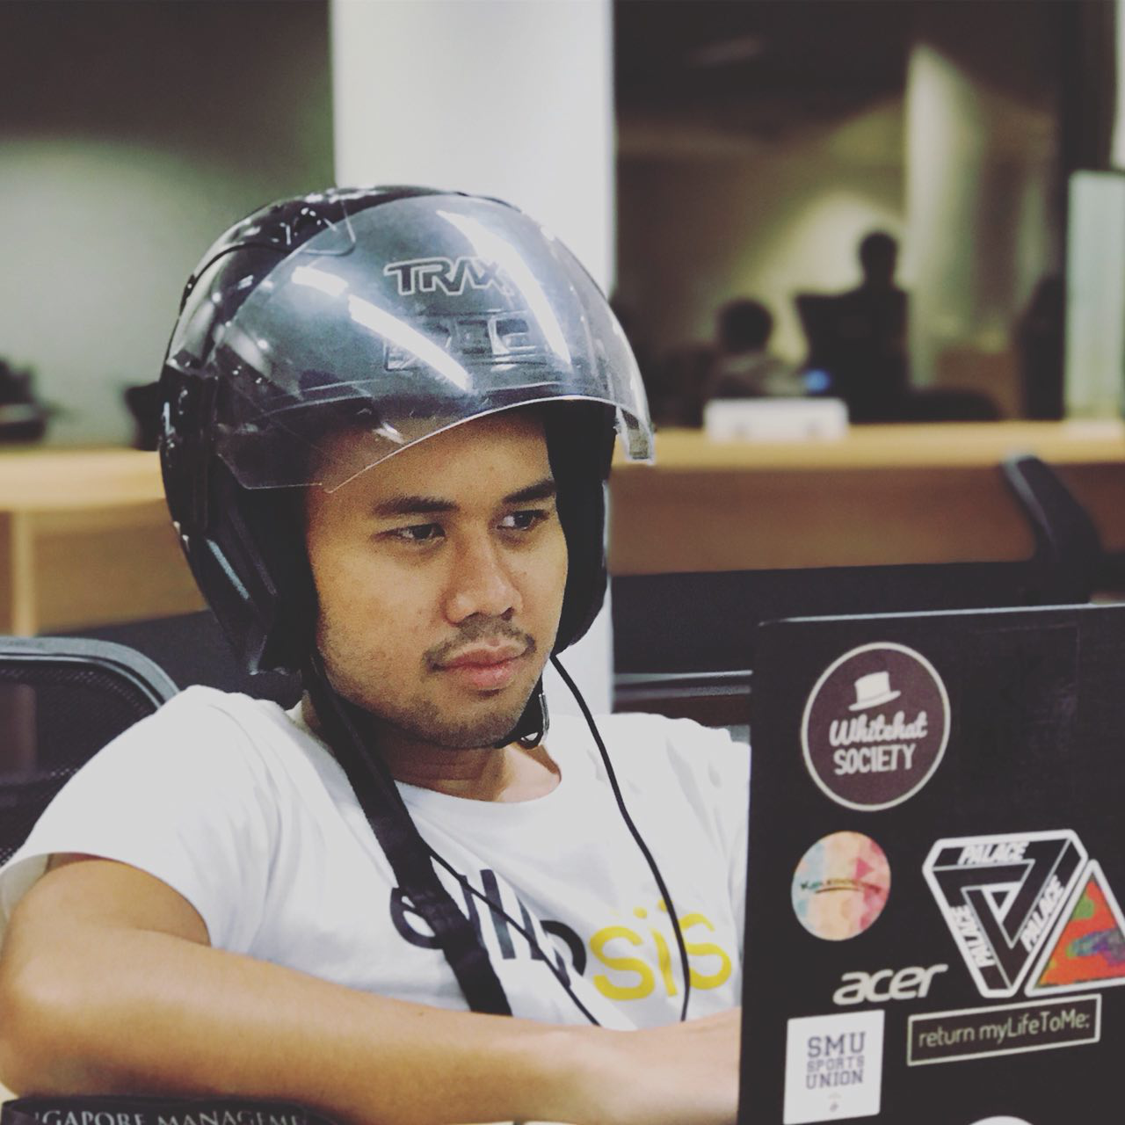
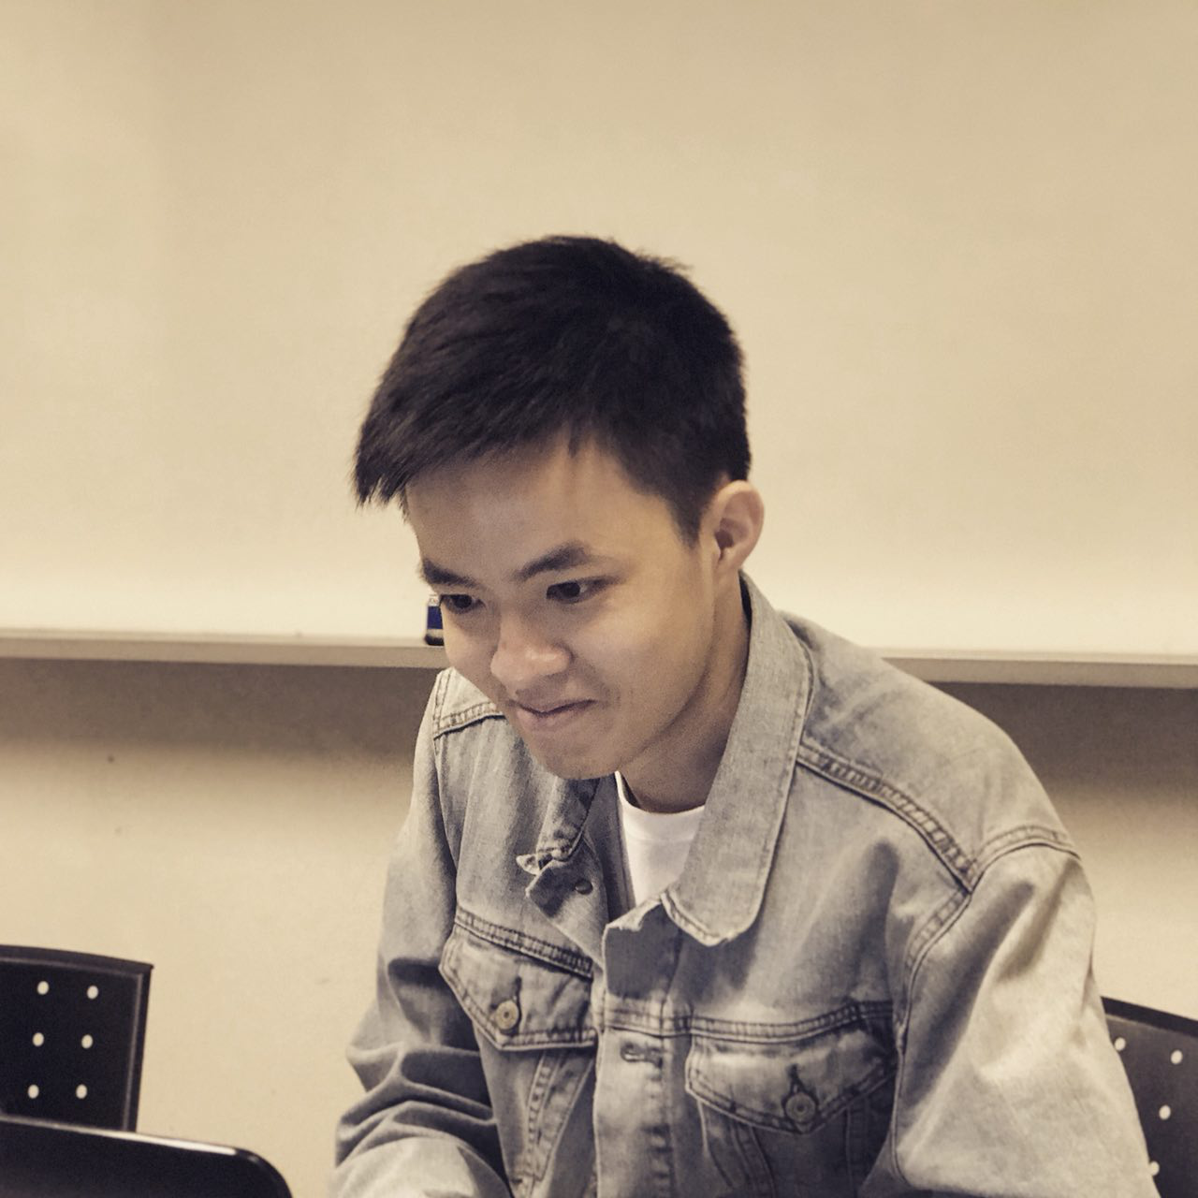
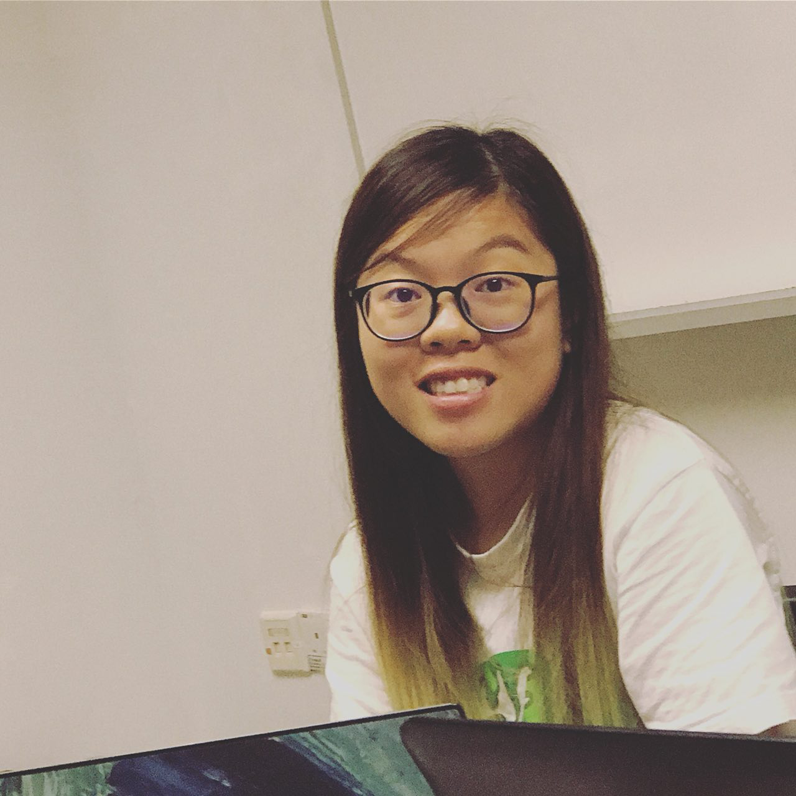
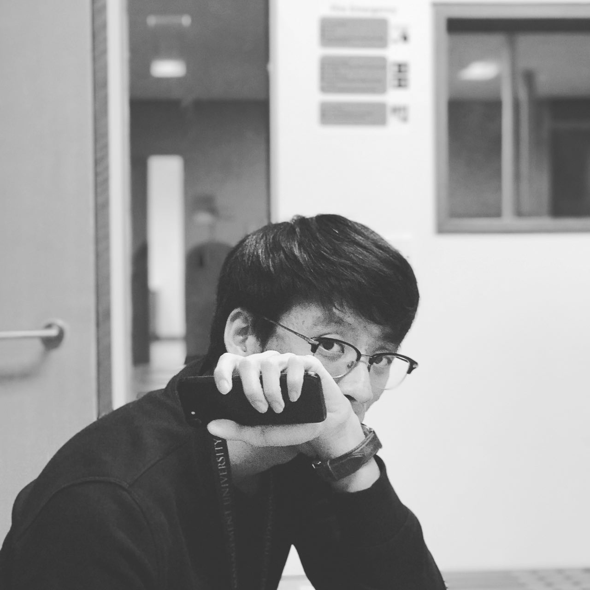


G6T3 – Young Tau Foo
Final presentation
young.tau.foo
Notes:
Notes:
Please present in this sequence.
You will have 10 minutes for your presentation. Decide wisely on how much time you want to allocate on each section. Make sure to do several dry runs so that you know how long your presentation actually takes.
Not everyone in the team needs to present but the whole team must be present during the presentation.
Everyone is expected to answer questions.
Questions can be directed to the team in general or any particular member of the team.
The order of the presentation will be random.
The presentation time will start whether or not all team members are present.
No formal attire required.
Participation will be judged based on the quality of the questions asked during the Q&A sessions.
Read the additional slides (in eLearn) for additional information about the presentation.

Slide 2
CONTENT
SCHEDULE
IMPROVEMENT FROM WEEK 10 PROGRESS UPDATES
WORK BREAKDOWN
TASK AND BUG METRICS
USE OF GIT
TEST SCORE
SERVER INFO
OTHERS

Slide 3
schedule

Slide 4
TIMELINE
1teration 1
Planned:
31/08 – 07/09
Actual:
31/08/ - 07/09
1teration 2
Planned:
12/09 – 26/09
Actual:
12/09 - 26/09
1teration 3
Planned:
26/09 – 08/10
Actual:
28/09 - 10/10
- Project requirements
- Use Case
- Learn Git, JSP, HTML
- Design BLR
- Design login
- Review
- Review & Goal Setting
- Login
- BLR – Breakdown
- Create login test cases
- Test login function
- Bootstrap design
- Bootstrap
- BLR – Top K Popular Places
- Code review
- PM Review Preparation
- BLR – Top K Popular Places
- Diagrams
- Integrate Connection Manager and MVC
- Program Admin Page
- Testing and Debugging
- Deployment and Testing
- Debugging

Slide 5
TIMELINE
1teration 4
Planned:
11/10 – 25/10
Actual:
13/10 - 25/10
1teration 5
Planned:
26/10 – 8/11
Actual:
26/10 – 8/11
1teration 6
Planned:
09/11- 22/11
Actual:
9/11 – Current
- Review & Goal Setting
- BLR – Top K Next Places
- Familiarize with JSON
- BLR – Top K Companions
- Integrating JSON
- UI Design
- Testing
- Debug
- Deploy & test
- Debug
- Review & Goal Setting
- Automatic Group Identification
- Heatmap
- UI Design
- Testing & Debugging
- Deploy & Test
- Debugging
- Buffer
- UAT deployment
- Review & Goal Setting
- Resolve UAT Issues
- UI Design
- Presentation Preparation
- Documentation
- Buffer
- Final Deployment

Slide 6
Drop/add FUNCTIONALITIES
Did not drop any functionalities
Did not add any additional functionalities

Slide 7
EXTERNAL LIBRARIES used
Bootstrap Theme SB Admin 2
gson-2.8.2.jar
joda-time-2.9.9.jar
commons-csv-1.5.jar
commons-fileupload-1.2.2.jar
commons-io-2.2.jar
is203-jwt-v2.jar (given in wiki)
json-smart-1.2.jar (given in wiki)
nimbus-jose-jwt-2.26.1.jar (given in wiki)
UnzipUtility class

Slide 8
PROBLEMS FACED WHEN SCHEDULING
S/N | Problems faced | How we overcame
1 | Inconsistent updating of schedule (E.g forget to update the schedule after a pair programming session.) | Remind each other about what we did so we can keep track of the schedule.
2 | Vague schedule being planned out, which results in having more unplanned session. | For subsequent iterations, PM has to break down the task more specifically and be clear about the task planned for the PP session.

Slide 9
IMPROVEMENTs FROM WEEK 10 progress updates

Slide 10
Improvements from week 10 progress updates
Comments received | Improvement Made
Major gap in programming hours (30hrs) | We have closed the gap of each member’s programming hours. Average hours per member is 47 hrs, range in programming hours is 44-52 hrs (8 hr gap) The ones with the least PP hours were given more PP sessions. The ones with the highest PP hours stopped PP sessions.

Slide 11
Work breakdown by each members

Slide 12
TASK ALLOCATION
Task | Denise | Gerald | Hidayat | Wei Kiat | Shen Ying
Login |  | ✔️ |  |  | ✔️
Bootstrap |  | ✔️ |  | ✔ | ✔️
Top K Popular Places | ✔️ | ✔️ | ✔️
Top K Companion | ✔️ | ✔️ | ✔️ | ✔️ | ✔️
Top K Next Places |  |  | ✔️ | ✔️ | ✔️
Breakdown of Gender, Year and School | ✔️ | ✔️ | ✔️
Heatmap | ✔️ |  |  |  | ✔️
Automatic Group Detection | ✔️ | ✔️ |  |  | ✔️
UI |  |  |  | ✔️ | ✔️
JSON | ✔️ | ✔️ | ✔️ | ✔️ | ✔️

Slide 13
TASK allocation
Task | Denise | Gerald | Hidayat | Wei Kiat | Shen Ying
Debug Login |  | ✔️ |  |  | ✔️
Fix Basic Location Report |  | ✔️ |  | ✔️
Debug Bootstrap with Validation |  | ✔️ |  |  | ✔️
Debug Top-K Popular Places | ✔️ | ✔️ | ✔️ | ✔️ | ✔️
Debug Top-K Next Places |  |  |  | ✔️ | ✔️
Integration of ConnectionManager class |  |  | ✔️ | ✔️
Integrate MVC | ✔️ | ✔️ | ✔️ | ✔️
Admin Update Page | ✔️ |  |  |  | ✔️
Debug Bootstrap | ✔️ | ✔️
Debug Top K Companion |  | ✔️ | ✔️ |  | ✔️
Debug JSON integration for Next Places, Popular Place and Bootstrap | ✔️ |  |  |  | ✔️

Slide 14
WORK BREAKDOWN PER MEMBER Programming (Coding, Debugging, integration) VS Non Programming (Design, Deployment, Testing)
 | Non Programming
Denise | Designing of diagrams Testing Creating Test Cases PM review preparation Video demo preparation Update diagrams
Gerald | Designing of diagrams Testing Creating Test Cases PM review preparation Video demo preparation
Hidayat | Designing of diagrams PM review preparation Video demo preparation Testing Creating Test Cases Update diagrams
Final Presentation Preparation
Bug Logs
Final Presentation Preparation
Bug Logs
Final Presentation Preparation
Bug Logs

Slide 15
Work breakdown per member Programming (Coding, Debugging, integration) VS Non Programming (Design, Deployment, Testing)
 | Non Programming
Shenying | Designing of diagrams Creating Test Cases Bug Logs PM review preparation Video demo preparation Testing Creating Test Cases Final Presentation Preparation
Wei Kiat | Designing of diagrams PM review preparation Video demo preparation Testing Creating Test Cases Bug Logs Final Presentation Preparation

Slide 16
PROGRAMMING HOURS
Members | Hours | % of total
Shen Ying | 56.89 | 21.04
Hidayat | 53.20 | 19.67
Wei Kiat | 54.03 | 19.98
Denise | 52.92 | 19.57
Gerald | 53.39 | 19.74
Total hours | Average hours | Stn Dev | Median | Min | Max | Diff
270.43 | 54.09 | 1.62 | 53.39 | 52.92 | 56.89 | 3.97

Slide 17
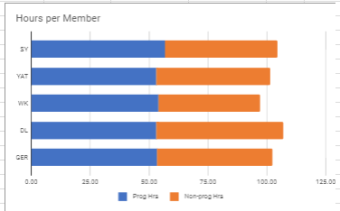
PROGRAMMING HOURS

Slide 18
TASK AND bug metrics

Slide 19
TASK METRICS
Iteration | Planned Tasks (#) | Actual Tasks (#) | Metric(%)
1 | 12 | 12 | 100
2 | 15 | 17 | 88.2
3 | 15 | 17 | 88.2
4 | 19 | 19 | 100
5 | 20 | 20 | 100
6 | 23 | 23 | 100

Slide 20
Bug metrics
Iteration | BM Score | Solved(%) | Action Plan
1 | - |  | -
2 | 1 | 100 | Planned to solve during buffer time, but ended up fixing during a PP session.
3 | 7 | 100 | Planned to solve during debugging time in the next iteration as the bug was discovered late in the iteration and there were other tasks that needed to be prioritised.
4 | 15 | 100 | Bug were handled during iteration. Other features were pushed back to account for bug solving time.
5 | 107 | 100 | Features were all completed with our own testing completed. UAT failed and there is a bug infestation. Using planned debugging time in Iter 6 to solve the bugs. Allocated more Debugging hours in Iter 6.
6 | 30 | 100 | Major debugging sessions were conducted based on the results from Iter 5. No need to halt development as functions and UI are already completed. Instead, most of the time in this Iter is spent debugging. Some bugs still found during testing sessions. Managed to solve them before Final Presentation deadline.

Slide 21
Use of git

Slide 22
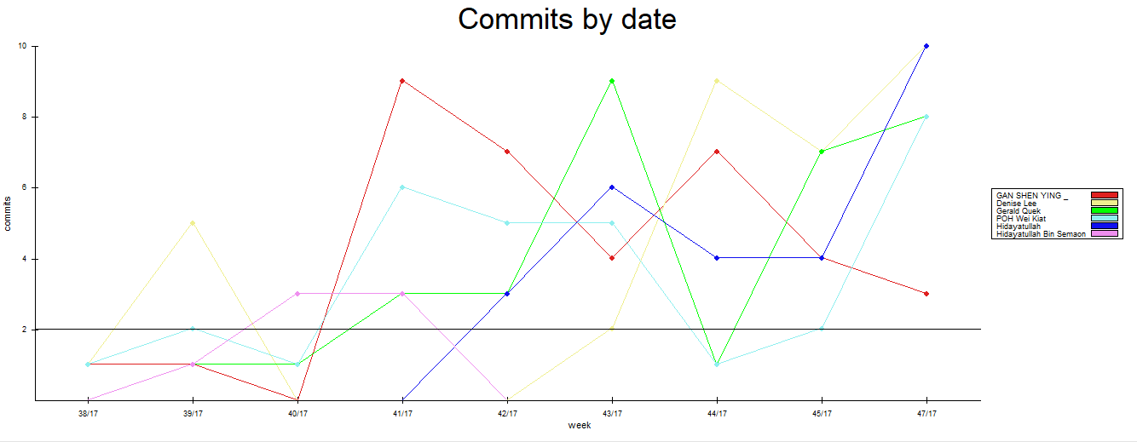
GIT WAS USED CONSISTENTLY

Slide 23
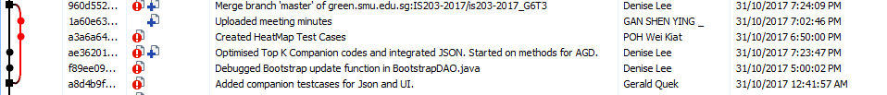
GIT WAS USED CORRECTLY
Make sure correct branch before merging files
Resolve conflict
Always PULL at the start of PP session
Write brief commit messages that describes what has changed

Slide 24
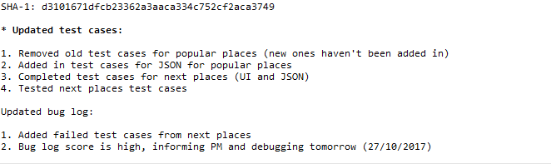
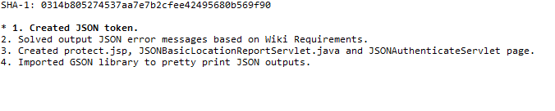
GIT WAS USED CORRECTLY
Commit Messages

Slide 25
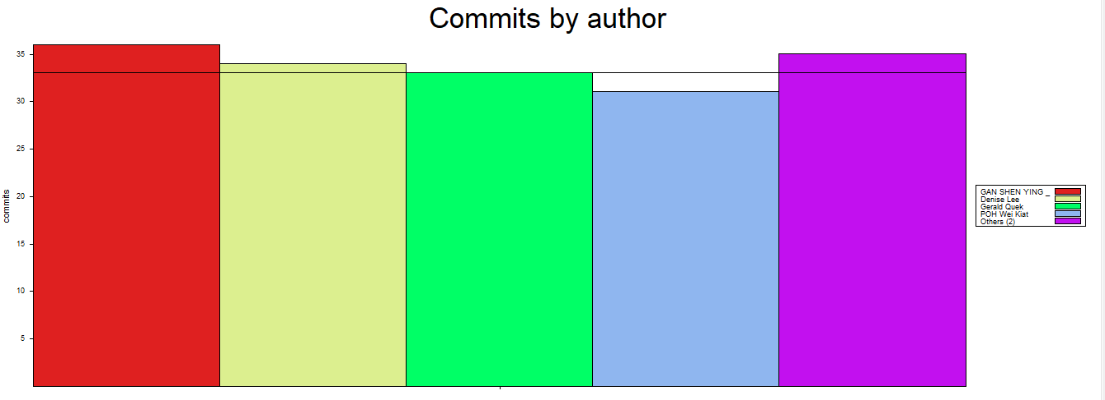
GIT WAS USED evenly
Shen Ying Denise Gerald Wei Kiat Hidayat

Slide 26
Test score

Slide 27
test score
After resolve UAT issues, all the test cases PASSED

Slide 28
Server info

Slide 29
Server info
IP address of AWS Server: 18.220.148.110
Tomcat manager password: TvmvfpaV1Xuj
Admin Username: admin
Admin Password: qwerty123

Slide 30
others

Slide 31
TAKEAWAYS
Effective communication among team members.
Improve on project management skills by being PM in different iteration.
Importance of planning and time management.
Changes always happen, it is important to learn how to adapt and be flexible.

Slide 32
TEAM CONFLICTS OR ISSUES faced
S/N | Issues | Action taken
1 | Differences in commitment level - Shen Ying and Gerald was involved in school election during recess week. | The rest of the members have put in extra effort during recess week so that we were able to prevent further delays.
2 | Team members have different commitment and priorities. | Prevent PP at night/midnight/weekend – Team members can spend spare time on other modules and personal time.
3 | Hidayat’s laptop malfunctioned during the recess week. | Re-install all the necessary software needed for the project and re-clone GIT repository on the new machine.

Slide 33
Interesting facts about young tau foos
A morning person
Has many Korean Boyfriends
Need to code with alcohol
Always sit near the power plug
Love to code on the table and floor

Slide 34
Thank you!

